Slide 1

InterNest
Empowering International Students Through a Social Connection and Support App
A holistic app designed for international students to combat homesickness, foster community, and provide tailored mental health support, empowering both introverts and extroverts in their new academic environments.
Notes:
International students often face challenges adjusting to a new culture, language, and educational system. Homesickness can be a significant challenge for international students, particularly introverts who find it challenging to express themselves in a new environment. To address this issue, we propose the creation of a holistic mental health and social support app tailored to the unique needs of international students.
Our app aims to go beyond mere combatting homesickness; it strives to create a vibrant and empathetic online community for international students to connect, share, and grow together.
Our app becomes a comprehensive platform that not only alleviates homesickness but also cultivates a sense of belonging and provides valuable mental health support to international students. Through meaningful connections and a rich array of resources, it empowers introverts and extroverts alike to thrive in their new environments.
The app offers features such as personalized matchmaking, real-time chat, cultural exchange programs, and access to mental health resources to create a supportive international student community. The app has the potential to make a real difference in the lives of international students.

Slide 2
— Jackie Chan
“We live now in a global village, and we are in one single family. It's our responsibility to bring friendship and love from all different places around the world and to live together in peace.”
Notes:
This Jackie Chan's quote refers to the interconnectedness of our world, emphasizing that despite geographical, cultural, and social/societal differences, we're all part of a global community. He highlights the importance of fostering bonds of friendship and love across borders to create a peaceful coexistence, suggesting that it's everyone's duty to promote unity and understanding among diverse cultures for a harmonious global society. Motivated by Jackie Chan's belief in a connected global family, I'm inspired to develop a social connection app that unites individuals from diverse backgrounds, encouraging friendships, cultural exchange, and mutual support. This app aims to foster a sense of unity, bringing people together to create a peaceful and inclusive community where everyone feels welcomed and supported regardless of their origins.

Slide 3

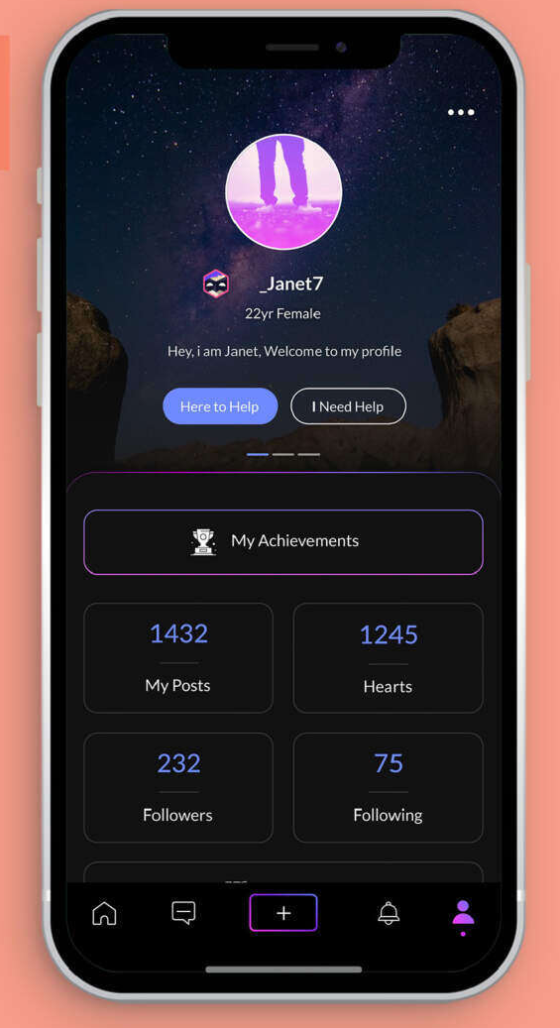
DELIVERABLES
Personalized Connections
Cultural Exchange
AI-Powered Matching
Mental Health Support
Engaging Social Interaction
Notes:
The app aims to enhance the experience of international students in various ways. First off, it allows you to create detailed profiles where you can share your interests, background, and the challenges you're facing. This feature helps in connecting you with peers who truly understand and relate to your experiences.
Utilizing advanced technology like AI and language processing, the app offers smart matching capabilities. It pairs you with other users based on commonalities such as interests, origins, and even your emotional state. It's like having a matchmaking companion that understands your preferences.
The app emphasizes real-time communication and interaction. It offers features like live chatting, group discussions on diverse topics, and engaging activities. The primary focus here is on fostering friendships and nurturing a supportive community among users.
One of the significant aspects is the provision of mental health support. The app offers a wealth of resources including articles, videos, and guided meditation sessions tailored to support mental well-being. Moreover, it facilitates connections with professional therapists or counselors for users seeking expert guidance.
Furthermore, the app promotes cultural exchange through various programs. Users can participate in language learning activities, attend virtual cultural events, and exchange cultural recipes. It serves as a platform for immersing oneself in different cultures while sharing one's own heritage.
The overarching goal is to bring this app to life, from the initial planning and design stages through rigorous testing to its eventual launch. The core aim remains improving the lives of international students by providing a comprehensive platform that caters to their needs and fosters a sense of belonging and support.

Slide 4
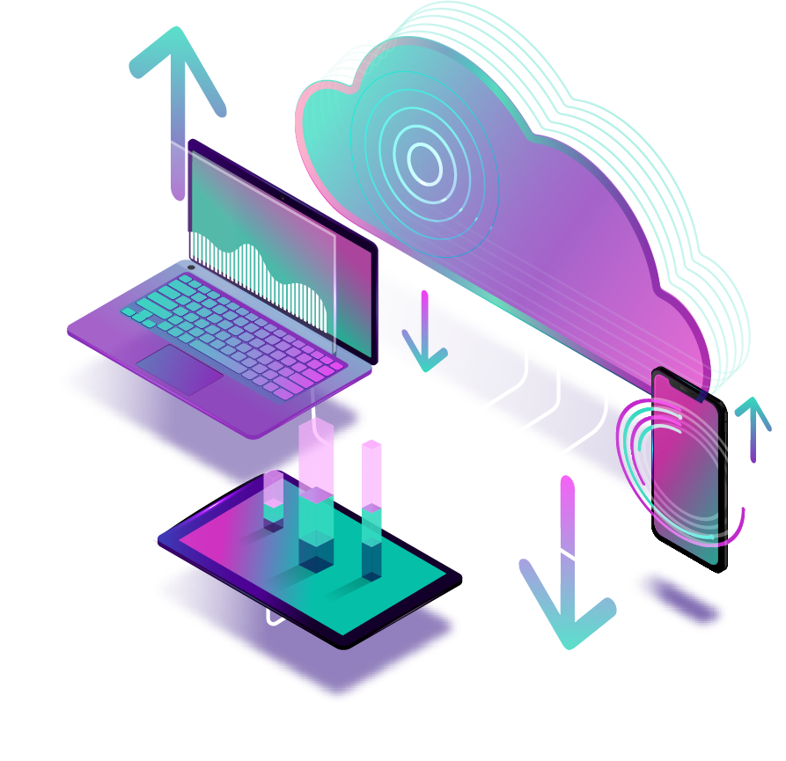
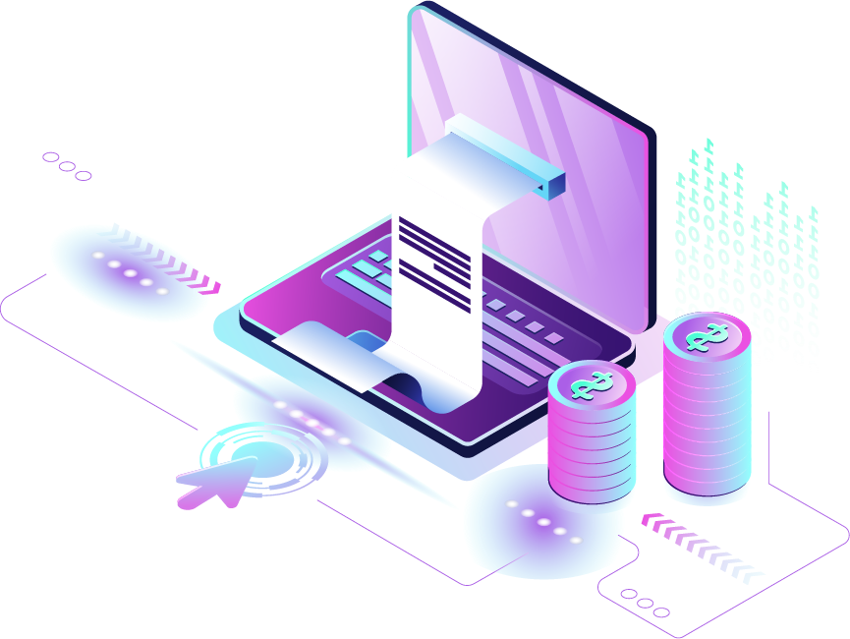
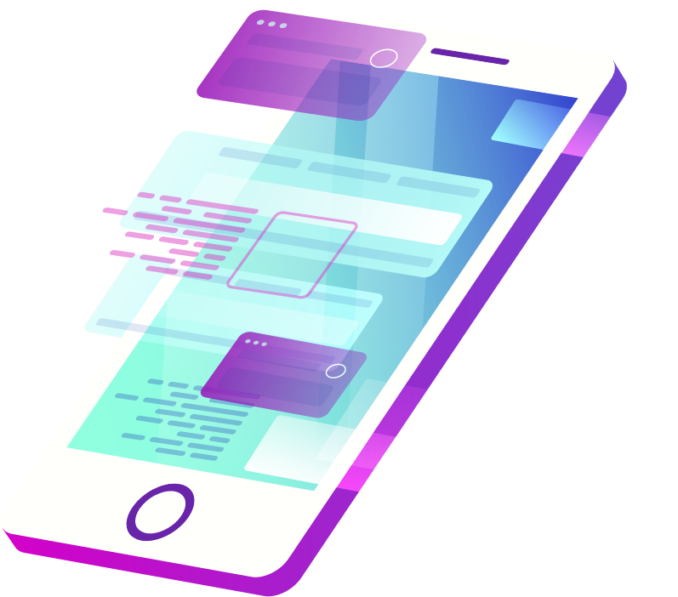
STRATEGY
Initiation
Information Gathering:
Conduct surveys and collect data to understand user needs
Design and Team Formation:
Collaborate with a UI/UX designer and form the development team
Planning
Execution
Development and Implementation:
Actively develop the app with features like AI-Matching, chat, and cultural exchange.
Monitor
Progress Monitoring:
Continuously monitor development progress to stay on schedule and within budget.
Control
Closeout
Testing and Quality Assurance:
Conduct rigorous testing to identify
and fix bugs and performance issues
Final Administration:
Prepare project documentation, data backup, and launch preparations.
Notes:
Our strategy to achieve these deliverables can be divided into various phases.
Phase One, Initiation and Planning, involves crucial groundwork. We begin by conducting surveys and gathering data to comprehensively understand the needs of our users. Simultaneously, we collaborate with a UI/UX designer and establish our development team, ensuring a strong foundation for the project.
Moving into Phase Two, Execution, Monitoring, and Control, our focus shifts to bringing the app to life. This stage involves active app development, incorporating essential features such as matchmaking, chat functions, and avenues for cultural exchange. Concurrently, we closely monitor the progress of development, maintaining a keen eye on adherence to both schedule and budget.
In the final Phase Three, Closing, we emphasize the importance of quality assurance. Rigorous testing procedures are implemented to identify and rectify any bugs or performance issues, ensuring a seamless user experience. Additionally, we handle final administrative tasks, preparing comprehensive project documentation, backing up essential data, and making meticulous launch preparations.
These distinct phases within our strategic plan are pivotal in ensuring the successful creation and launch of our international student support app. Through systematic planning, diligent execution, and meticulous attention to detail, we aim to deliver an app that not only meets user needs but also exceeds expectations, providing a robust platform for fostering a supportive community among international students.

Slide 5
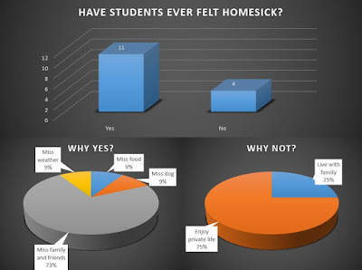
MONITORING AND EVALUATION
Objective Assessment: Crucial for gauging project effectiveness.
User Engagement Metrics: Monthly Active users, session duration, and app usage frequency monitored regularly.
Homesickness Impact Assessment: Pre- and post-app surveys to track changes in reported levels.
Mental Health Support Tracking: Usage and feedback analysis for inclusivity.
User Retention Analysis: Understanding factors behind user churn for improvements.
Accessibility and Inclusivity Focus: Audits and feedback to enhance app accessibility.
User Satisfaction Monitoring: Regular surveys to analyze satisfaction levels.
Data-Informed Decisions: Utilizing data for adjustments and decision-making.
End-of-Project Evaluation: Comprehensive assessment of project success.
Notes:
Monitoring and evaluating our objectives is crucial to understand our project's effectiveness. Our dedicated Monitoring and Evaluation (M&E) team will track key indicators throughout.
We'll measure user engagement through metrics like Monthly Active Users (MAUs), session duration, and app usage frequency using analytics tools, setting quarterly benchmarks.
Community growth will be assessed by analyzing user-generated content and interactions within the app.
To gauge the app's impact on reducing homesickness, we'll conduct pre- and post-app surveys. We'll track mental health resource usage and gather user feedback while ensuring inclusivity for introverted and extroverted users.
Analyzing user retention and factors contributing to churn will guide improvements, while partnership success and outreach effectiveness will be measured by institutional numbers and outreach impact.
We'll address accessibility through audits and user feedback, striving for inclusivity.
Regular user satisfaction surveys will track scores and reasons behind fluctuations.
The M&E team will use this data to inform decisions, make necessary adjustments, and demonstrate project impact to stakeholders. An end-of-project evaluation will assess overall success in achieving our outlined objectives and results.

Slide 6
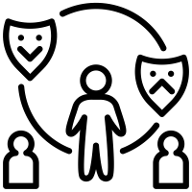
OBJECTIVES
What is the Scope?
The scope of the project involves developing a comprehensive mental health and social support app tailored specifically to address the challenges faced by international students at Indiana University.
Foster Meaningful Connections
Reduce Homesickness
Provide Access to Professional Support
Maintain a Diverse User Base
30%
increase in user engagement within the first month.
Project Justification
20%
decrease in self-reported homesickness levels over three months.
Address challenges of the growing international student population.
Enhance well-being through connections, homesickness relief, and mental health support.
Promote cultural exchange and inclusivity.
Provide a competitive advantage.
Ensure long-term advantages for the university.
90%
users connected with licensed therapists within 24 hours.
Satisfy both introverted and extroverted international students.

Slide 7
Key Features
Detailed profiles, AI-powered matching, real-time interaction, mental health support, and cross-cultural experiences.
COST
Initiation and Planning Phase
Allocate $5,000 for hiring a UI/UX designer
Allocate $21,000 for app developers
Execution, Monitoring, and Control Phase
Monitor development progress
Closing Phase
Allocate $7,000 for rigorous testing and quality assurance
Allocate $3,000 for final administrative tasks.
SCHEDULE OBJECTIVE
Timeline: 3 Months
Initiation and Planning Phase
(Sep 5, 2023, to Oct 6, 2023)
Execution, Monitoring, and Control Phase
(Oct 7, 2023, to Nov 21, 2023)
Closing Phase
(Nov 22, 2023, to Dec 7, 2023)

Slide 8
ASSUMPTIONS
Sufficient Demand
User Adoption
Technical Talent
Timeline Feasibility
Establishing Partnerships
User Feedback
Constraints
Budget
Timeline
Dependency on Third-Party Providers
Technical Capabilities and Limitations
Legal and Regulatory Compliance

Slide 9
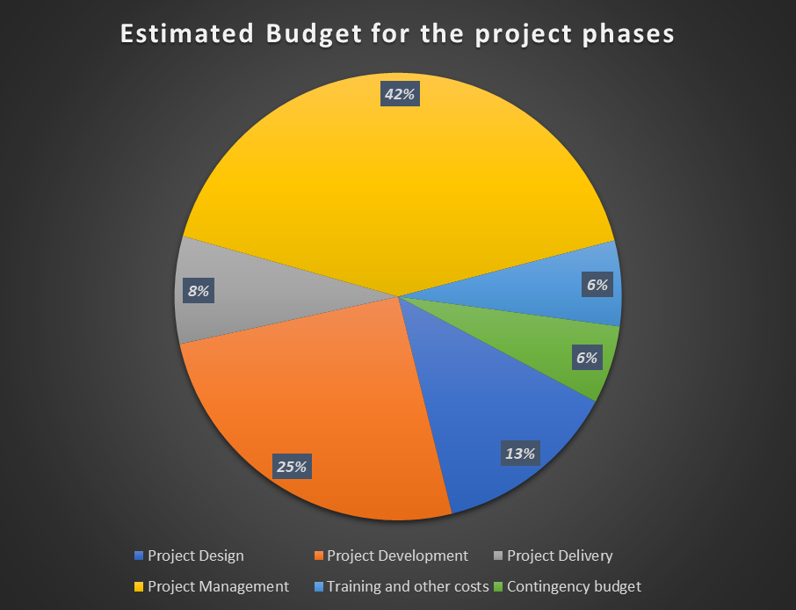
PROJECT BUDGET OVERVIEW
ESTIMATED BUDGET
$230,460
The Project Management phase comprising of third-party vendor interface and quality assurance was allocated the majority expense out of the estimated budget, followed by design and development testing- hardware and software, and labor cost-planning.

Slide 10

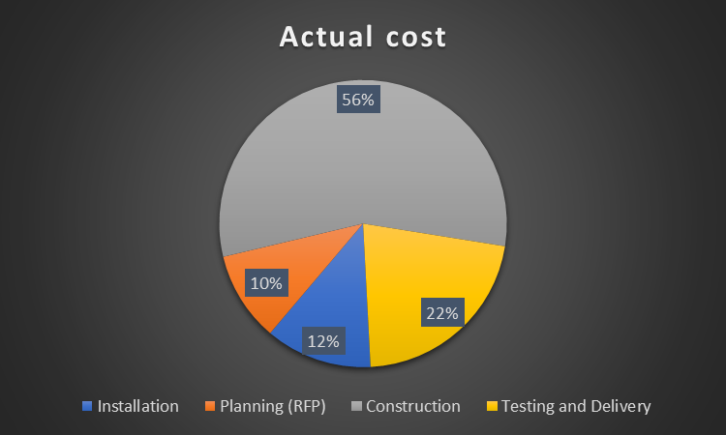
ACTUAL COST
$208,000
As opposed to our estimated project budget of $230,460, we utilized only $208,000. The major part of this budget was utilized in the construction and testing phases.

Slide 11
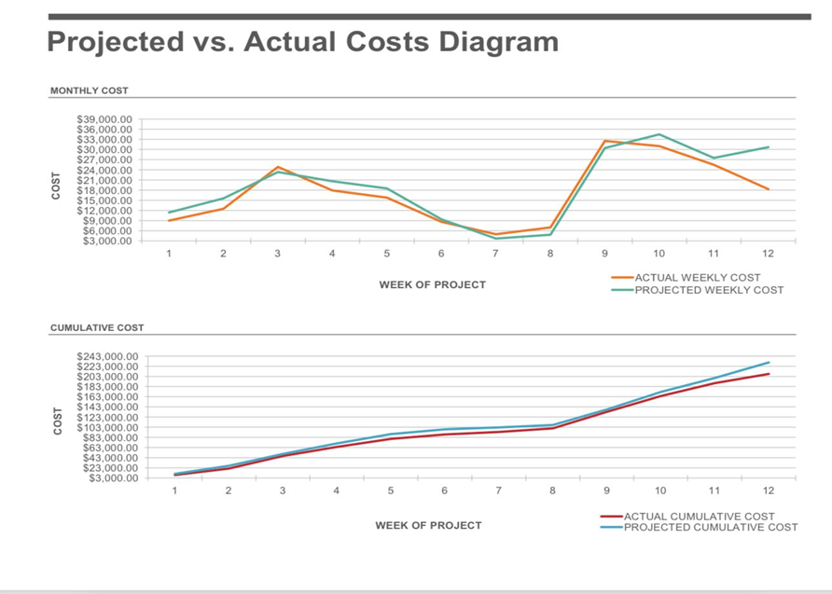
OBSERVATIONS
The projected costs are consistently higher than the actual costs.
The difference between the projected and actual costs is greatest in the early stages of the project.
Monthly projections varied from the actual during the execution stage.
The difference between the projected and actual costs decreases over time and aligns more closely in later stages.

Slide 12
BUDGET NOTES
Conclusion:
Effective Budget governance so far.
On track to meet objectives and complete within approved budget.
Continued cost oversight critical through project completion.
Overall, Effective Budget Governance has kept the project financially on track to meet objectives while delivering significant value.
Continued cost oversight is indeed the key to completing within the approved budget of $230,460.
Recommendations:
Track labor hours efficiently.
Explore lower software procurement costs.
Confirm testing and development standards.
Increase contingency buffer for potential overruns.

Slide 13
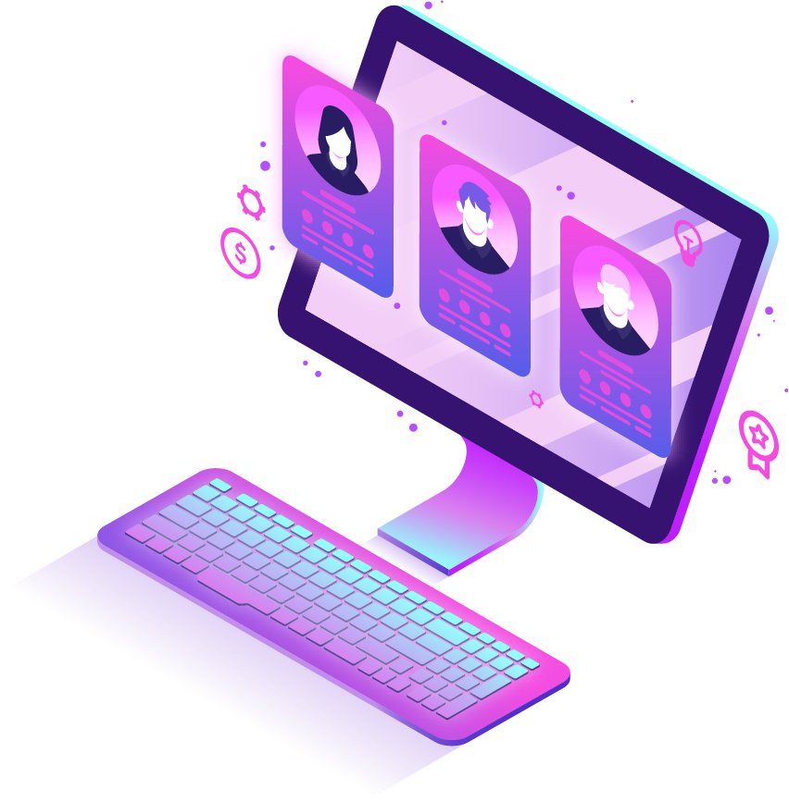
WORK BREAKDOWN STRUCTURE
INITIATION: Fixed weekly meeting schedule & Finalized Project Idea
PLANNING: Conducted Market Research, set deadlines for all phases, estimated project budget, noted risks involved, allocated resources.
CLOSURE: Worked on Feedback & Improvised app & Finally Launched App into Market.
MONITOR & CONTROL: Collected Feedbacks & Survey Analysis, Implemented Referrals for attracting more users!
EXECUTION: App Design, Development, Security &Testing

Slide 14
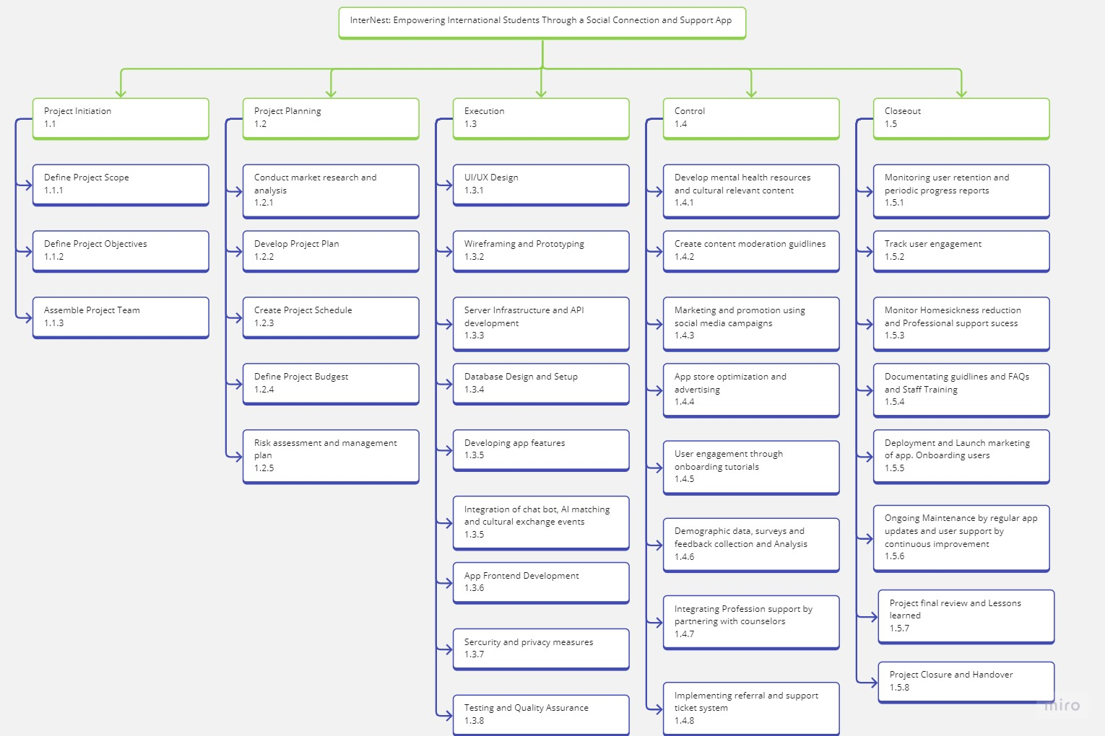
WBS is used to organize the team's work into manageable sections.
It also used to provide a structured vision of the deliverables.
We need to Identify the main deliverables, break down deliverables into smaller components
Let’s discuss how WBS helps in project planning, cost estimation, resource allocation, and risk management.

Slide 15
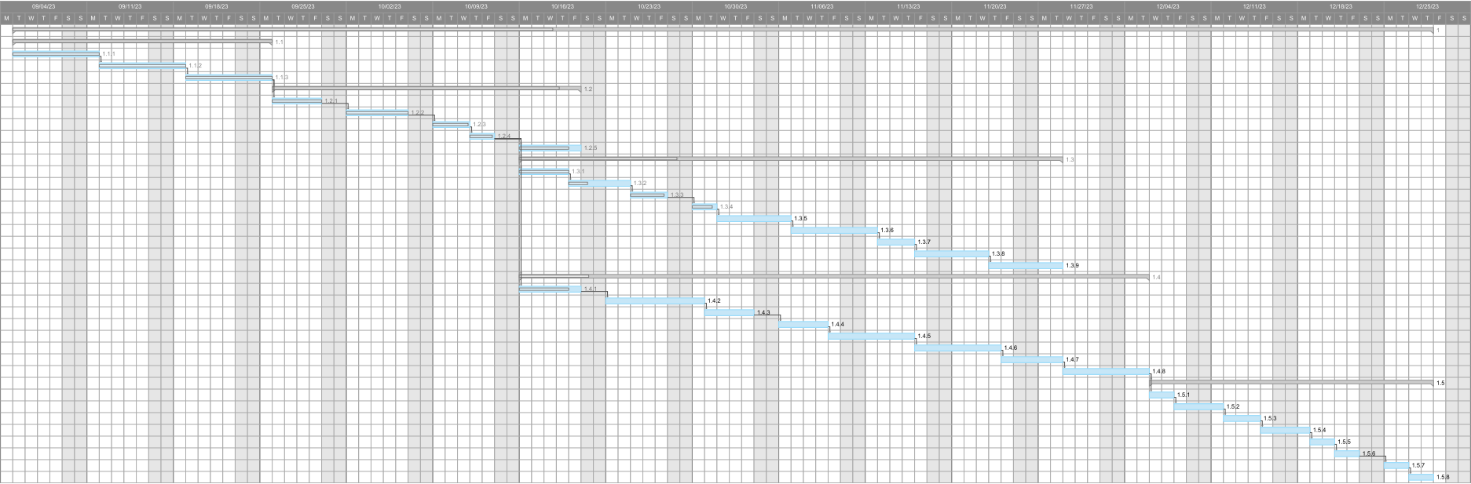
WORK PLAN – GANTT CHART
Project Initiation
Project Planning
Execution
Gantt Chart provides the timeline and progress of tasks/activities in project.
Control
It also indicates dependencies between tasks.
Sometimes, until one task is finished, we can't go on to the next one.
Each task's bar on the chart represents its duration.
We can keep track of all the tasks and how much time each has taken.
Longer bars represent tasks with longer durations, while shorter bars represent shorter tasks.
Gantt charts also include information about resource allocation, such as assigning specific team members or resources to each task.
Closeout

Slide 16
COMMUNICATION PLAN
Execution Phase:
Host Daily 20min standups for developing team to sync on blockers.
Demo app build updates every 2weeks to gain user feed back.
send weekly updates to stakeholders on progress.
Closeout Phase:
User Feedback Meetings: Schedule monthly user feedback sessions throughout project.
Gather direct insights into what users like/dislike about the app, identify priority areas for improvement based on user input.
Incorporate meaningful charges to continuously enhance user experience.
Initiation Phase:
Hold kickoff meeting with all stakeholders to introduce project vision, goals, timelines.
Send regular email updates on progress to key stakeholders.
Create shared online workspace for documents and discussion.
1
3
5
2
4
Planning Phase :
Conduct weekly status update meetings with developer team and designers.
share user research findings and prototype designs for feedback.
Update project plan docs in shared workplace as needed.
Monitoring Phase:
Analyze Usage data and user feedback to create improvement plans.
Update status docs with latest metrics dashboards and results.
Hold post-launch review meeting discuss learning with team.

Slide 17
What | Who/Target | Purpose | When/Frequency | Type/Method
Kick-off meeting | All Teams | Define goals, Budget, Scope | Once on September 5, 2023 | In Person Meeting
User interviews | International students, Functional Team | Collect data for analysis | Daily from Sep 15 - Sep 20 | Virtual Meeting
Design reviews | Designer Team, Project team, All stakeholders | Discuss UI/UX enhancements. | Weekly Sep 29 - Nov 17 | Virtual Meeting
Development updates | Developer Team, Project team, All stakeholders | Monitor development | Weekly updates from Sep 29 - Nov 17 | Email with link to report
Content Creation updates | Content creation Team, Resource control Team | Plan language programs and mental health resources. | Biweekly meeting | In person Meeting
Testing updates | QA team, All stakeholders | Share app testing progress | Weekly update reports from Oct 27 - Nov 17 | Email
Bug reports | QA team, Developer Team | Report identified bugs | Ad hoc meeting to rectify bugs and issues | Reported through Email
Launch plan | Entire Project Team, Marketing team, All stakeholders | Finalize tasks for app launch. | Once on Nov 17 for planning the app launch | In Person Meeting
Social media posts | Marketing team, All stakeholders | Promote app via social media | Weekly from Sep 27 – Dec 5 | In Person Meeting
User feedback collection | International students, Functional Team | Receive user’s feedback on the app's functionalities | Monthly meeting to Collect feedback | Survey, Email, Virtual Interviews
Project Advisory Meetings | Functional Team, Core Team, Project Team | Hold specialized team meetings | Biweekly meeting from Sep 5 – Dec 7 | In Person Meeting
THE USER FEEDBACK meetings are critical for guiding app enhancements that truly resonate with target users. Continuously selecting and integrating user perspectives ensures we build an app that meets international student's evolving needs and preferences.

Slide 18
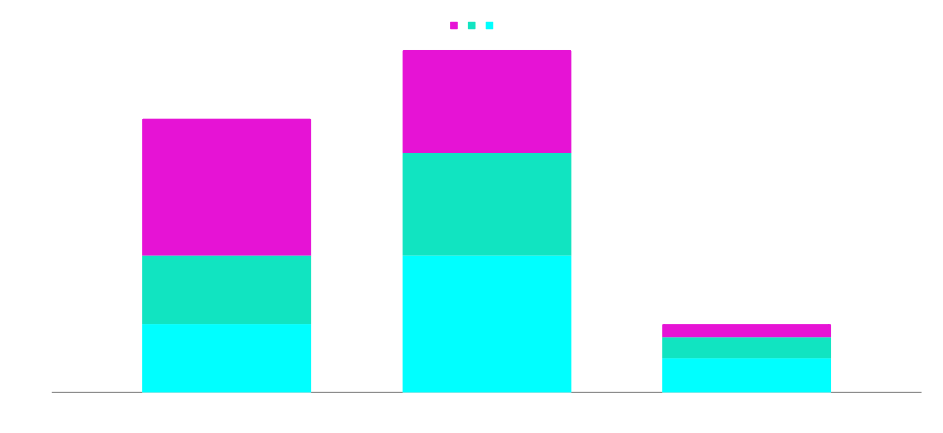
MODE OF COMMUNICATION
For our project in a daily schedule, 10% of meetings are conducted in person, 20% virtually, and 5% via email.
On a weekly basis, 10% are in-person meetings, 15% are virtual, and 3% are conducted via email.
Bi-weekly meetings involve 20% in-person sessions, 15% virtual meetings, and 2% are carried out through email exchanges.
Mix of Meeting Formats: Utilized a blend of in-person and virtual Zoom meetings for project discussions, allocating 40% to in-person sessions and 60% to remote collaboration.
Benefits of In-Person Meetings: In-person meetings facilitated team bonding and enhanced productivity, especially for collaborative tasks and specialized equipment access.
In-Person Brainstorming: These sessions were ideal for brainstorming sessions where the use of a whiteboard and rapid, collaborative idea exchange were pivotal.
Remote Collaboration via Zoom: Zoom allowed for inclusion of remote team members, flexible scheduling, and accommodated different time zones, constituting 60% of meeting time.
Flexibility and Screen Sharing: Zoom enabled flexible meeting times, facilitating clear demonstrations of work-in-progress through screen sharing.
Cost Reduction: Utilizing Zoom for remote collaboration reduced travel costs that would have been incurred for exclusive in-person meetings.
Bi-Weekly
15%
Bi-Weekly 20%
Weekly
15%
Weekly 10%
Daily
20%
Bi-Weekly 2%
Daily
10%
Weekly 3%
Daily 5%

Slide 19
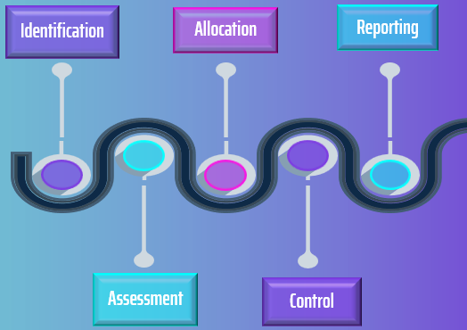
RISK ANALYSIS
3
3
2
Impact
4
Poor App store Performance
4
Low User Retention and Engagement
3
Excessive Operational Expenses
3
Technical Development Challenges
5
Challenges in integrating Chat Bot AI
3
Content Gaps or User Data collection issues
3
Installation delays and Challenges
Ineffective Marketing Campaigns
UI/UX Design Issues
Improper Project Closure and Handover

Slide 20
RISK NAME | DESCRIPTION | RPN | RISK OWNER | DURATION
Project Management Challenges | Challenges in project planning and coordination | 64 | Project Manager | Dec 7 - Dec 21
Poor App Store Performance | App performance affecting user downloads | 60 | Marketing Team | Nov 22 - Dec 7
Low User Retention and Engagement | Risk of low user retention and engagement | 60 | User Engagement | Nov 22 - Dec 7
Software License Procurement Delays | Delays in software license acquisition | 48 | Procurement Team | Oct 7 - Nov 21
Security System Challenges | Challenges in implementing security measures | 48 | Procurement Team | Nov 22 - Dec 7
Insufficient Ongoing Maintenance | Challenges in app updates and user support | 45 | App Development | Dec 7 - Dec 21
Excessive Operational Expenses | Risk of financial overspending | 40 | Finance Team | Dec 7 - Dec 21
Technical Development Challenges | Challenges impacting project progress | 36 | Technical Lead | Oct 7 - Nov 10
Server Hardware and Network Issues | Issues with server and network upgrades | 36 | Procurement Team | Nov 22 - Dec 7
Integration Challenges | Challenges in integrating advanced app features | 36 | Integration Manager | Nov 22 - Dec 7
Testing Challenges | Test package not aligned with project requirements | 30 | Test Manager | Oct 7 - Dec 7

Slide 21
RISK MITIGATION
Use project management software: Optimize planning and tracking.
Monitor app store performance: Assess advertising returns.
Analyze user retention: Suggest retention-boosting measures.
Maintain alternative licenses: Monitor procurement closely.
Optimize resource use: Ensure cost-effectiveness.
Conduct design reviews: Collaborate on design regularly.
Test advanced features thoroughly: Prepare fallback plans.
Analyze data regularly: Guide decision-making with trends.
Complete site surveys: Ensure pre-installation readiness.
Monitor social media campaigns: Enhance strategies as needed.
Evaluate support system: Improve support efficiency.
Transfer deliverables as planned: Ensure seamless handover.
Update content using feedback: Keep content relevant.
Risk Identification and Validation
Risk Examination and Analysis
Risk mitigation strategies follow a logical pattern and continuous loop to ensure that risk is identified, analyzed, prioritized, strategized, scrutinized and digitized.
Risk Monitoring and Reporting
Risk Mitigation Strategy

Slide 22
KEY TAKEAWAYS
What was successful about your project?
- Supportive online community for international students
What can be improved about your project?
- Improvements in user retention and more robust feedback loops
What did you learn from the project?
- Effective team collaboration, adaptability and user-focused design
Can you use this knowledge?
- Yes
How will you use this knowledge?
- Prioritizing Teamwork, Staying Adaptable, and Focusing on user feedback
What did you learn from this class?
- Planning, Risk management, Leadership, Adaptability, Quality control, Stakeholder management, Continuous evaluation and improvement
Notes:
What was successful about your project?
Our project successfully created a supportive online community for international students. The app fostered meaningful connections, offered mental health support, and facilitated cultural exchange, culminating in a vibrant and empathetic space for students to thrive.
What can be improved about your project?
There's room for improvement in user retention strategies and establishing more robust feedback loops. Enhancing strategies to retain users for more extended periods and refining feedback mechanisms will contribute to sustained engagement and continual improvement.
What did you learn from the project?
The project taught us the value of effective team collaboration, adaptability, and the importance of user-focused design. Collaborating efficiently within the team, being adaptable to evolving needs, and prioritizing user-centric design were pivotal lessons learned.
How will you use this knowledge?
We'll apply this knowledge by prioritizing teamwork, fostering collaboration, staying adaptable to changing circumstances, and consistently focusing on user feedback. These principles will guide our approach to future projects, ensuring user satisfaction and project success.
What did you learn from this class?
From this class, I gained insights into planning, risk management, leadership, adaptability, quality control, stakeholder management, and the importance of continuous evaluation and improvement in project management. These learnings will be instrumental in orchestrating future projects effectively, emphasizing comprehensive planning, risk mitigation, leadership strategies, and continual improvement methodologies.

Slide 23
THANKS
PROJECT TEAM:
Shivani Raut
Arun K Soora
Hymavathi Gummudala
Meghana Darla
Samantha Sanjeev
Sanjana Rajan

